Slide 1
2021 GAIN
Module 5:
Computational Tools for Data Science
Dr. Thomas Parchman
Associate Professor
Biology Department
tparchman@unr.edu
Trevor Faske
PhD student
Ecology, Evolution, and Conservation Biology

Slide 2
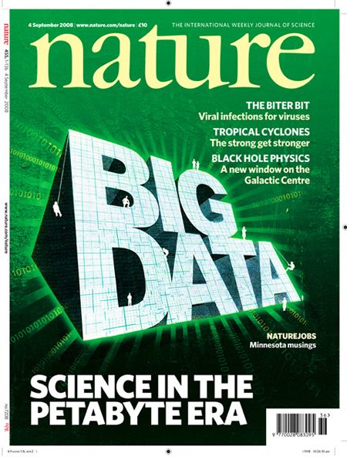
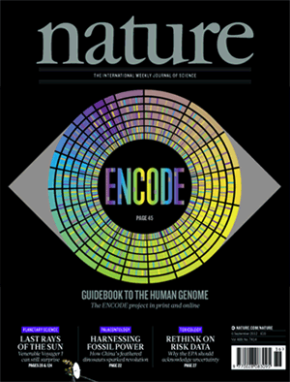

Slide 3
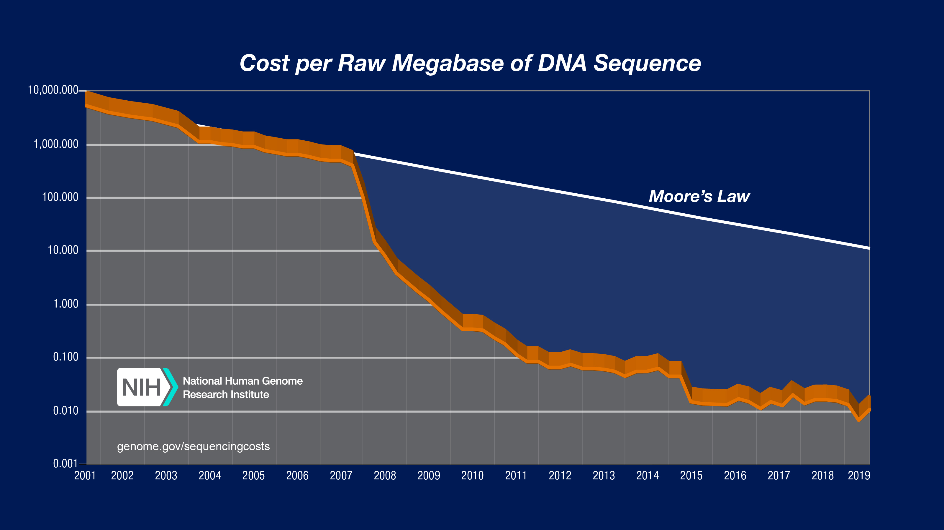
Big Data Science: Genomics
Next generation
sequencers debut
Cost of DNA sequencing is now 1,000,000 times cheaper and about 100,000 times faster than 10 years ago

Slide 4
Human Genome Project (1990- 2003)
First draft human genome released in 2003.
- 3,000,000,000 dollars, 13 years, 100s of people
De novo whole genome sequencing today
- About $25,000 for a genome of a non-model organism
- Nature 2020: One paper with 350 bird genomes

Slide 5
Big data is relevant for all of science
Scientists are spending less time generating data
and
more time handling and analyzing data

Slide 6
GAIN Module 5: An introduction to tools to facilitate working with bigger data
Unix/Linux – operating system which facilitates efficient computation, handling and manipulation of big data, and High Performance Computing.
Python – interpreted programming language used widely across disciplines in both academia and industry

Slide 7
Why learn Unix?
Accessing, manipulating, and moving large data around (around your computer, or among computers).
Working on remote computers and high-performance computing clusters.
>250,000 built in tools and commands, can be used for efficient scripting of workflow.
First step at becoming enabled for data science and more generally for data handling and analysis.

Slide 8
Why learn Python?
- Among the most common languages used in biology and other fields of science. Thus, you will find a lot of documentation, guidance, examples, and opinion on the internet.
- Excellent capabilities for manipulating text, suiting it well to bioinformatics and data science, and pretty much anything else.
- It uses consistent syntax, which makes learning specific code relatively easy.
- It has many built in libraries to facilitate common tasks.
- If you learn this as your first language, it will make learning others much easier.

Slide 9
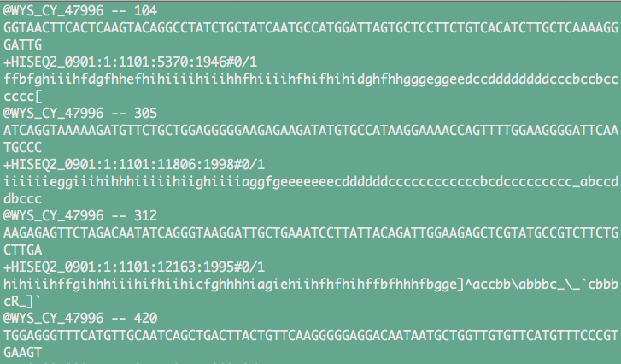
Information from the first four DNA sequences from a file containing data for 1.5 billion DNA sequences generated with an Illumina NovaSeq instrument

Slide 10


Slide 11

High performance computing clusters are accessed and run with Unix (or Linux)
Unix tools: ssh, sftp, wget, ftp, job schedulers (slurm, sungrid engine)

Slide 12
At the end of this module, you should:
1. Be comfortable with using Unix for basic navigation and data manipulation
And feel equipped to start learning more
2. Be able to write basic programs in Python (and feel encouraged to learn more on your own).
And feel equipped to start learning more
3. Feel enabled to work with big data, and motivated and capable of learning more on your own.

Slide 13
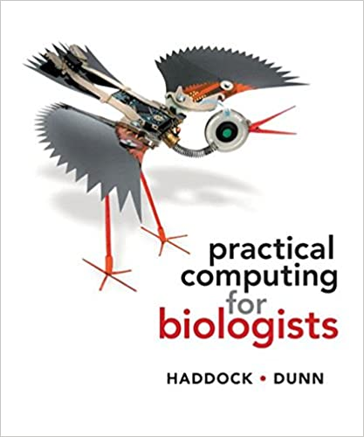
Course Resources
1. Computer with Unix and Python installed, preferably mac or machine running linux.
2. Supplementary data and problem sets for projects will be provided on the module github page.
3. Recommended book (to left), and supplemental unix material from ”Unix and Perl to the Rescue”, Bradnam and Korf.

Slide 14
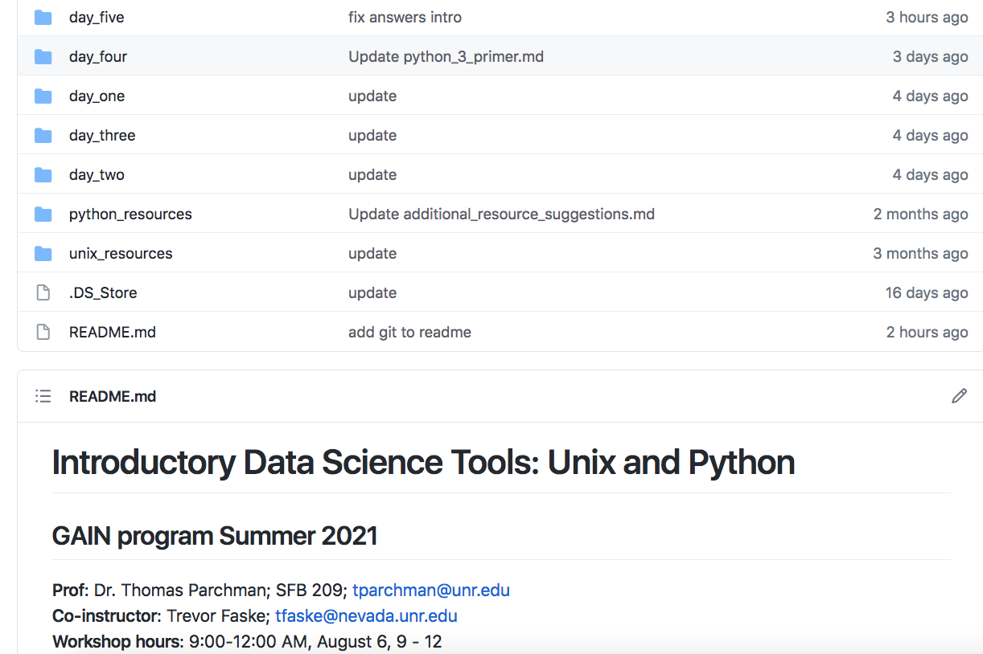
Module site: https://github.com/tparchman/GAIN_summer2021
Primers and task/problem assignments
Supplemental material for learning Unix and Python
Repositories for sharing code with each other

Slide 15
Other suggested resources:
Primer for a supplemental book that is very useful for Unix (and Perl if you so desire)
http://korflab.ucdavis.edu/Unix_and_Perl/current.html
- Python documentation:
https://docs.python.org/3/
- Online Python for Biologists (by Martin):
https://pythonforbiologists.com/introduction
- Learn Python Interactive (has built in interpretter)
https://www.learnpython.org/
- Python guru (excellent, has built in interpretter)
https://thepythonguru.com/
*I suggest bookmarking a few of the above and revisiting regularly

Slide 16
Day 1: Introduction to Unix
- directory navigation, moving, copying, syncing
- basic Unix tools for efficient data handling
Day 2: Python I
- getting oriented with Python
- first Python scripts, variable types, data structures
Day 3: Python II
- lists
- conditionals, loops (if, else, while, for)
- input/output
Day 3: Python III
- libraries
- regular expressions
Day 5: Python IV
- some useful libraries for data work
- Numpy, Pandas

Slide 17
A note on text editors:
- Programs are typically just text files; they contain text written commands for operations, functions, input/output, etc.
- Microsoft Office Documents and Excel documents are NOT text files; We will NOT be using either.
- Syntax recognition is built into editors used for programming (VIM, Emacs, TextWrangler, BBedit)
**This will help with understanding the code you are writing, and more importantly in debugging.

Slide 18
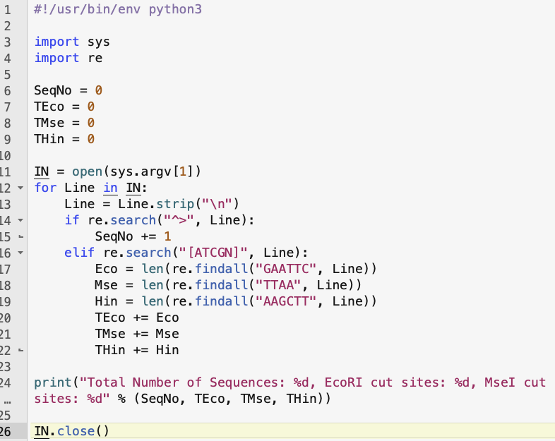
BBEdit – Recommended for this module
Python
script

Slide 19
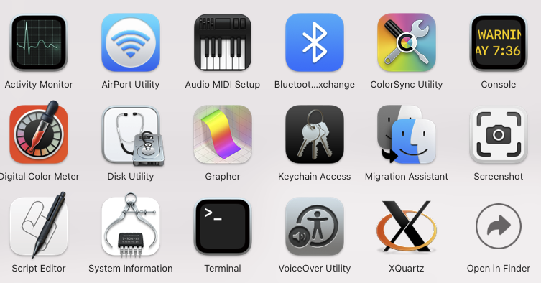
Introduction to the Unix terminal
Applications -> Utilities
Put a link somewhere to make opening this quick, as you will use it for everything in this course (add it to dock on a mac)

Slide 20
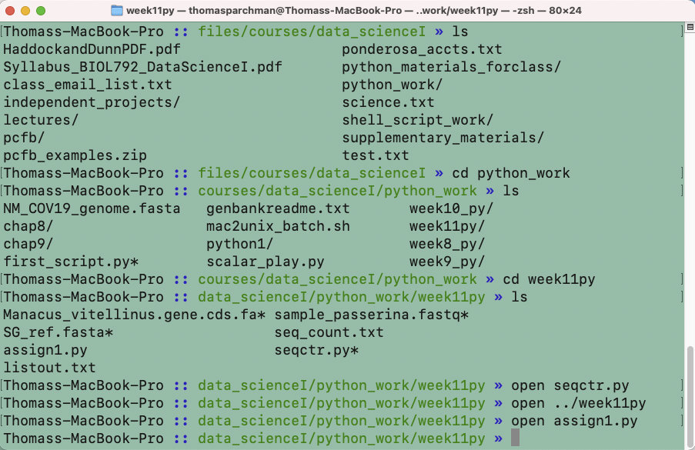
- make the text larger/smaller (hold down ‘command’ and either ‘+’ or ‘–’)
- have multiple terminal windows on screen (see the ‘Terminal’ menu)
- have multiple tabs open within each window (again see the ‘Terminal’ menu)
- Command ‘N’ to open additional windows

Slide 21
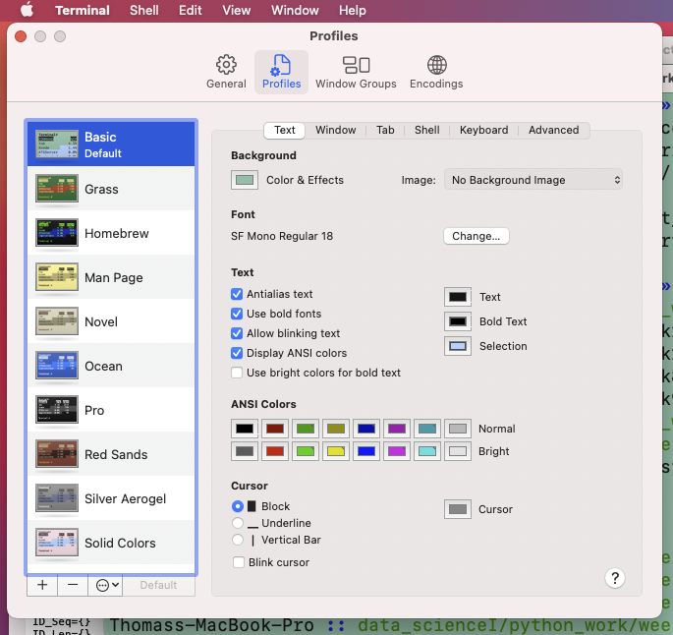
Customize Terminal
Background color,
text size, font, color, etc.

Slide 22
Unix terminal can be used for nearly everything
Moving, copying, removing, organizing and analyzing data
Running programs (we will run Python scripts from the terminal)
Connecting to other computers and networks.
Virtually anything else you can imagine.
** All Unix commands work from the prompt
There are tens of thousands of Unix/Linux commands, depending on the system you are using.

Slide 23
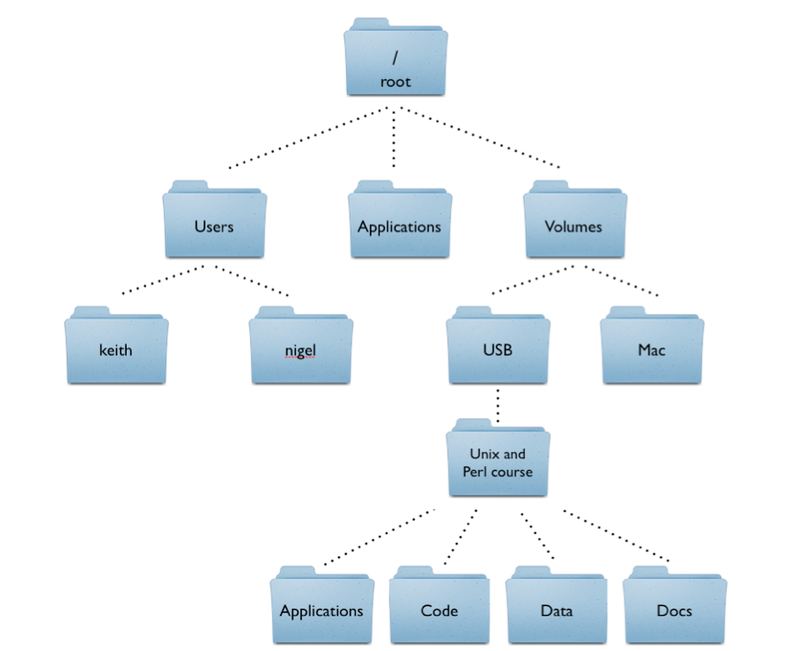
Unix directory structure
Root: indicated with a forward slash
/Users
/Users/keith

Slide 24
Introduction to Unix commands:
Listing the content of directories
“$” refers to the terminal prompt
$ ls
Lists directory contents
$ pwd
This will tell you the path to the directory you are in.
“print working directory”
As you learn Unix you will frequently type commands that don’t work. Commonly, this will be because you are in the wrong directory. You will use the pwd command a lot.

Slide 25
Unix Commands
Unix commands are short: less typing
Unix commands have command line options, or arguments
$ ls –l
will list directory contents along with other information
For example:
-rwxr--r--@ 1 parchman staff 5680 May 19 11:40 filter.sh*
drwxr-xr-x 7 parchman staff 238 Jun 2 13:10 lgc/
drwxr-xr-x 4 parchman staff 136 Jul 2 10:01 new_citations/
-rw-r--r--@ 1 parchman staff 413 Jun 11 14:54 queue.txt
-rw-r--r--@ 1 parchman staff 2260 Jun 30 13:45 readme_deviance.txt
drwxr-xr-x 22 parchman staff 748 Jul 8 10:21 ship/
drwxr-xr-x 11 parchman staff 374 Jun 9 20:41 xbill_BWA/

Slide 26
Introduction to Unix commands:
Change directory (cd) $ cd directory_name
$ cd ../
moves up one level
$ cd ../../../
moves up three levels
$ cd ~/Desktop/files/courses
move to courses directory
$ cd ~
moves from anywhere to home directory
$ cd /
move from anywhere to root
$ cd .
“.” means current directory.

Slide 27
Introduction to Unix commands:
Making, renaming, copying, moving files
$ touch filename.txt
creates a file
$ cp file destination (e.g., $ cp filename.txt ~/BIOL792/)
Copies a file to the directory specified
$ mv file destination (e.g., $ mv filename.txt ~/BIOL792/)
Moves a file to the directory specified

Slide 28
Introduction to Unix commands:
Making, renaming, copying, moving directories
$ mkdir directory_name
creates a directory
$ rmdir directory
Removes the directory specified. **** DANGER
$ mv directory destination
Moves a directory to the directory specified

Slide 29
A word on typing less:
Tab complete will save you most of the typing time at the terminal. Once a directory, file, or program name has been typed to the point of being unique, hitting tab will complete the text. THUS, you do not need to type out things all of the way.
Tab complete will save you time AND will prevent you from mis-typing command, directory and file names incorrectly
*Play around with this immediately while working through the tutorial and worksheets this week

Slide 30
Shortcuts for moving faster from the command line
(Your mouse is useless).
Up and Down arrows will allow you to scroll through previous commands that have been typed from the terminal. This will be very useful..
You can not use your mouse to move the terminal cursor.
- “control a” will move the cursor to the start of what you have typed.
- “control e” will move the cursor to the end of what you have typed.
- “control l” will clear the window
Try these as you work through the tutorial today

Slide 31
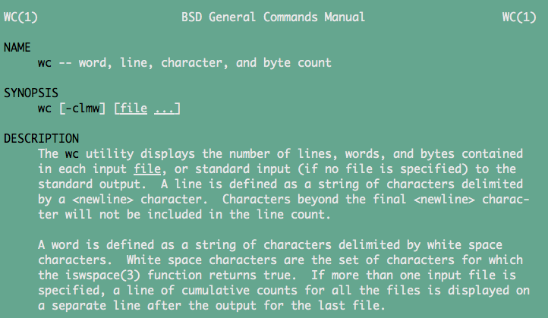
Manual (man) pages exist for every Unix command
List of command line options, and a synopsis of how the program works
- “man” is the unix command for opening the manual page
$ man wc
Opens the manual page for wc in less

Slide 32
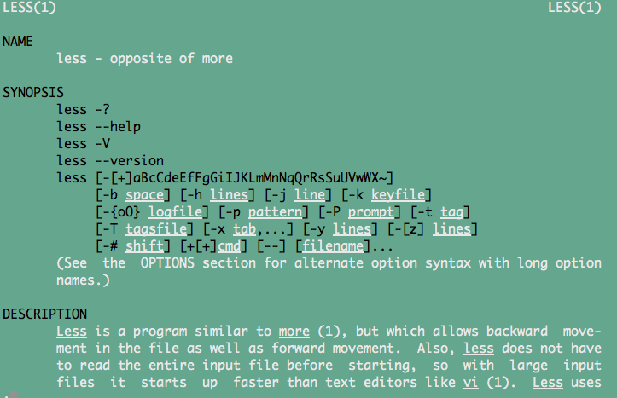
man (manual) pages
$ man less
Manual for less, a unix program for looking into files

Slide 33
For this morning:
Review unixI_primer.md under day_one
Work through unix_assignment1.md (mostly a tutorial), and complete the first few sections of one or both of the tutorials specified at the bottom of unix_assignmentI.md.
-For the unix_assignment1.md and unix_assignment2.md tutorials, you will want to download sample_passerina.fastq.gz and science.txt from the the course website, under day_one.
As an alternative introduction to Unix: Read the unix_buerkle_guide.pdf available under the unix_resources page. This is an excellent primer that covers some of the basic material we will cover during this module.

Slide 34
Other useful resources for getting started
- Unix cheat sheets, and guides under “unix_resources” on course site
- Useful primer from "Unix and Perl to the Rescue", by Bradnam and Korf. (http://korflab.ucdavis.edu/Unix_and_Perl/current.html)
- Also, please have a look at the excellent tutorial from software carpentry (http://swcarpentry.github.io/shell-novice/).

Slide 35
Hands on Unix time

Slide 36
Unix II
Altering .zshrc (or .bash_profile) to control terminal behavior for protection and efficiency
Viewing and editing text files (less or bbEdit/TextWrangler or nano)
File compression, decompression
Using Unix tools to work with some DNA sequencing data

Slide 37
Changing command names with aliases is useful, but risky
$ alias ls = “ls –l”
Changes the default behavior of ls, looks useful
$ alias mv = “cp”
Potentially bad
**Store carefully thought-out aliases in .zshrc or .bash_profile

Slide 38
Removing files or directories (can be dangerous)
$ rm file.txt
Will remove file. PERMANENTLY. FOREVER.
Use the –i option as protection
$ rm –i file.txt
remove file.txt?
Recommended: alter your profile to always call rm –i when typing rm at the command prompt

Slide 39
.zshrc or .bash_profile
- Contains specifications that control the way the terminal works
- Aliases allow you to create a customized name for a command, or a set of commands with specified options
- Aliases can be set in .bash_profile or .zshrc (depending on terminal used by your system) to improve efficiency and safeguard against bad consequences.
- As most of you are using new apple mac computers, you will be using the zsh terminal and hence this file will be called .zshrc

Slide 40
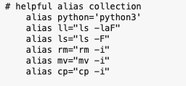
.zshrc:
This file resides in your home directory. It is a “hidden” file. The “.” in front of such a file prevents it from being normally listed with ls
$ less .zshrc
We want to add alias commands to this file in order to make your shell safer and perhaps more useful.
-for e.g., rm is dangerous with its default behavior

Slide 41
.zshrc (or .bash_profile)
Go to the profile section of unixII_primer.md, follow closely to understand and alter .zshrc.
If this file doesn’t exist, the simply make it in your home directory and name it .zshrc.
Alternatively, you can download the simple example .zshrc file from under day_one on the course page.
To activate, restart terminal application

Slide 42
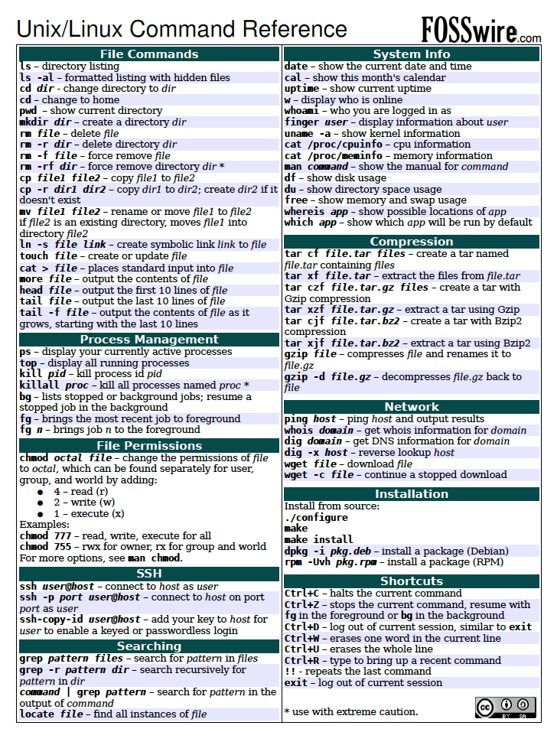
Unix cheat sheet on course webpage under “unix_resources”
I suggest keeping his on hand for now, but being comfortable with most of these commands before working on any computing clusters
There is a similar python cheat sheet in the same location

Slide 43
When to use a text viewer rather than editor:
You might not know which program your computer would ‘automatically’ use to open that file
You don’t know the size of the file. Big data files will typically be too big to open with one of your text editing programs.
Sometimes you just want to look to understand the structure of file content
When you are sure you don’t want/need to edit

Slide 44
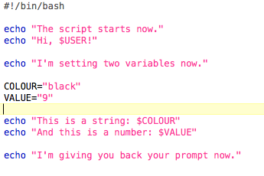
Editing text files outside of the terminal
Text Editors (bbedit, VIM, emacs): good for working on code because they have syntax recognition.
$ open simple.sh OR $ open –a bbedit simple.sh

Slide 45
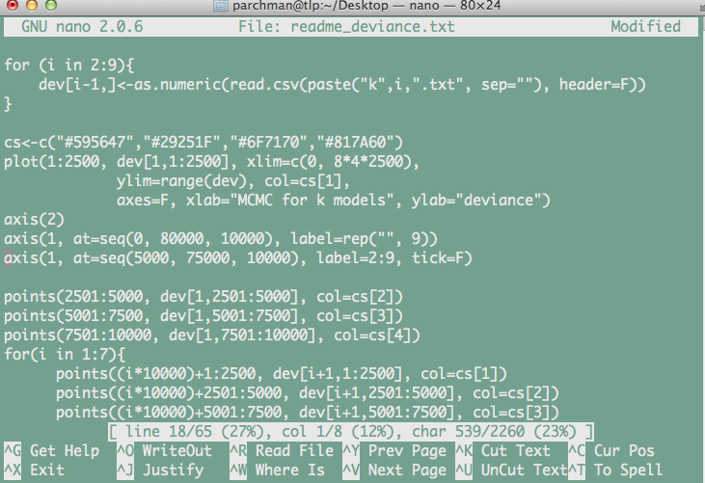
Editing text inside the terminal
Sometimes it will be easier to edit text files from within the terminal (e.g., when you are connected to a remote server or HPC system)
nano: A simple unix text editing program. Learn the basics.

Slide 46
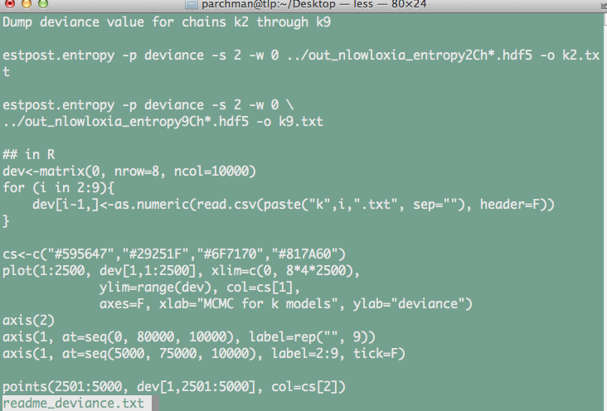
A word on line endings:
While working in Unix and Python you will quickly realize that line endings are themselves characters, although they are hidden
You nearly always want to use UNIX line endings.
Text file with Unix line endings, viewed with less

Slide 47
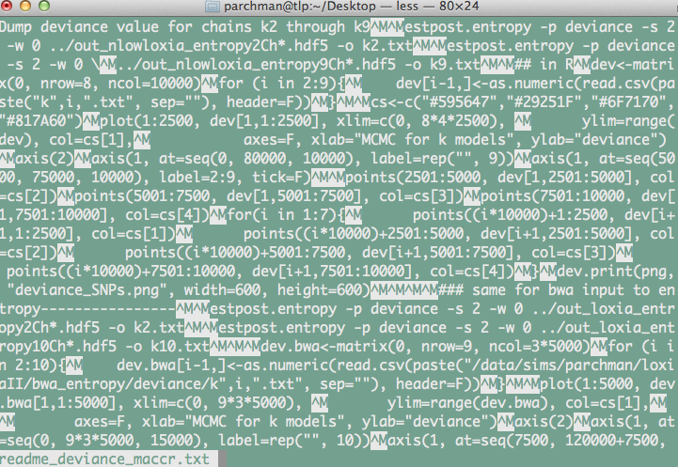
Same file with but with Mac line endings, viewed with less

Slide 48
File compression/decompression
$ gzip sample_passerina.fastq
This will compress sample_passerina.fastq and rename it sample_passerina.fastq.gz
$ gunzip sample_passerina.fastq.gz
This will decompress sample_passerina.fastq.gz

Slide 49
What is STDOUT?
When you execute a unix command, this is what prints to the terminal.
For example:
$ ls
-STDOUT is the printout of directory contents
$ tail file.txt
-STDOUT will be the last part of that file
We will often want to “redirect” (>,>>) that output to another file or “pipe” (|) it into another program

Slide 50
Redirection (>,>>)
$ ls > directory_contents.txt
$ cat *data.txt > loggerdata_alldays.txt
$ cat newdata.txt >> loggerdata_alldays.txt

Slide 51
Other tools for working with text files:
$ cat sample_passerina.fastq #prints entire contents to shell
$ cat sample_passerina.fastq | less #pipes output to less (so you will see 1 page at a time)
$ head –n 1000 sample_passerina.fastq #prints first 1000 lines to shell
$ head –n 1000 sample_passerina.fastq > 10000lines.fastq #writes the first 1000 lines to a new file

Slide 52
grep: regular expression engine, text extraction.
- Among the most widely used Unix commands in data science
Works one line at a time for a given file, fast
Returns lines containing pattern matches
The pattern can be an exact pattern, or a flexible regular expression, which we will learn about A LOT more when we start learning perl
File contents of fruitlist:
applesauce
apple fritters
peach ice cream
Squash is not a fruit
banana
scrapple
strawberry
Apple festival
$ grep apple fruitlist.txt
Will return all lines containing the pattern match

Slide 53
$ grep [options] <pattern> <file>
$ grep apple fruitlist.txt > applelines.txt
#Will write the lines containing the pattern match to the file “applelines.txt”
$ grep –c apple fruitlist.txt
#Will return the COUNT of the number of lines containing the pattern match
$ grep –V apple fruitlist.txt
#Will return the lines that DON’T match the pattern

Slide 54
Process monitoring/control
$ top #shows a list of what processes are running on your computer
**quit top with “q”
$ ps aux #shows process ids (PID), you can use these with kill
$ kill 9031 #kills a job with a supplied PID e.g.:
Use Ctrl-C to Interrupt a Job running in the shell
Append a "&" to a command to start it in the background

